Slide 2
Digital Forensics Lecture-25
By- Dr.subhranil Das
Assistant Professor
School of computer Science

Slide 3

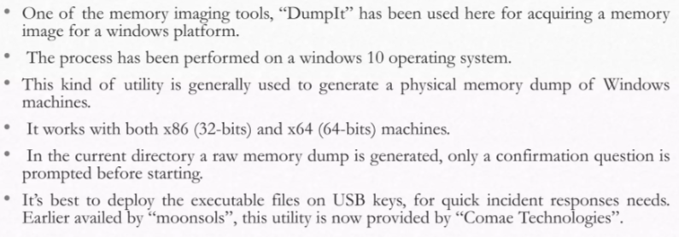
Memory Imaging Processing

Slide 4
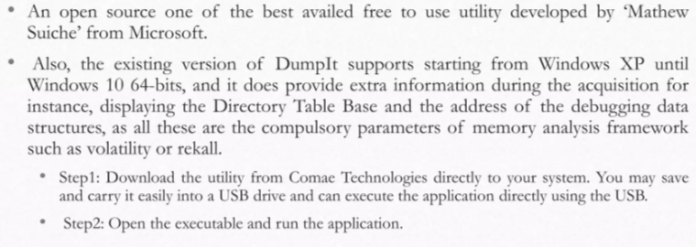
Memory Imaging Processing

Slide 5
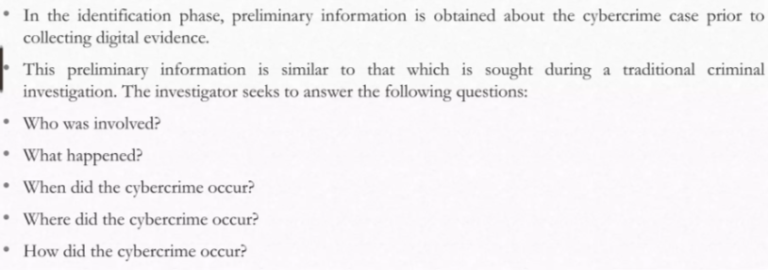
Identification

Slide 6
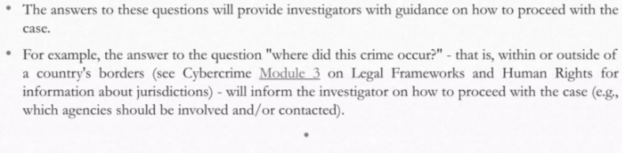
Identification

Slide 7
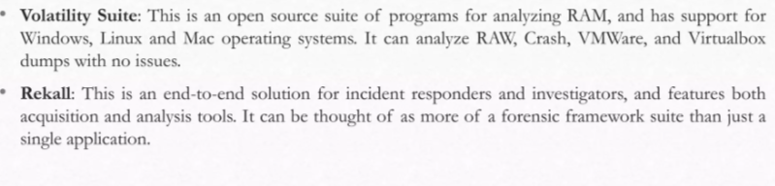
Memory Forensics Toolkit

Slide 8
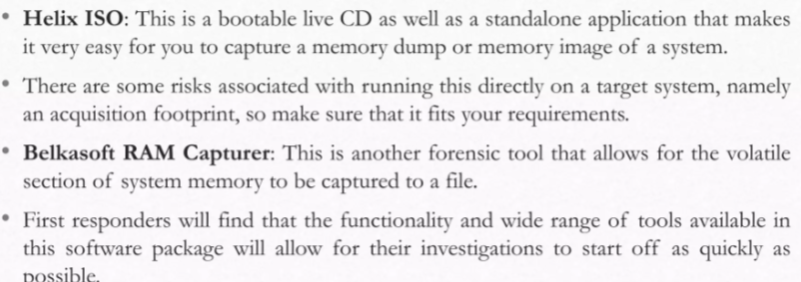
Memory Forensics Toolkit

Slide 9
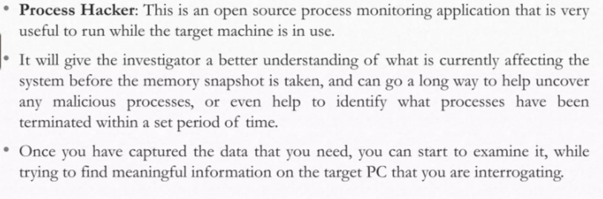
Memory Forensics Toolkit

Slide 10
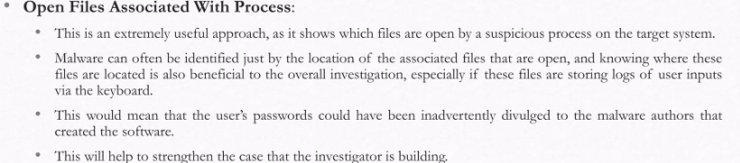
Examining the captured data

Slide 11
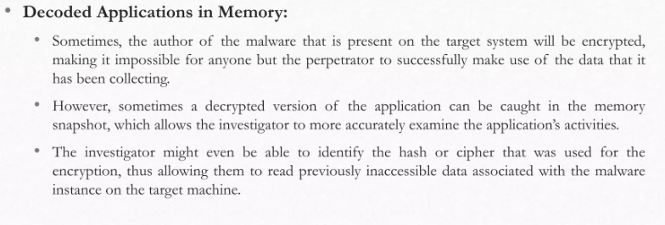
Examining the captured data

Slide 12
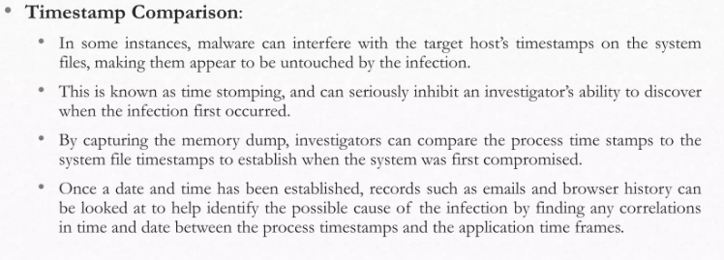
Examining the captured data

Slide 13
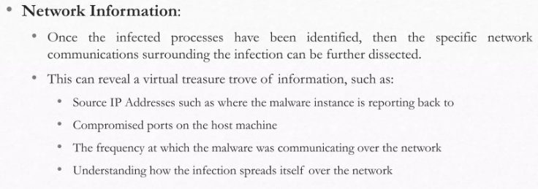
Examining the captured data

Slide 14
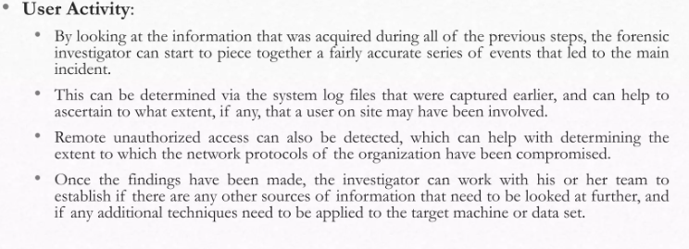
Examining the captured data

Slide 15
Next Lecture
Unit 4
.

